Slide 1
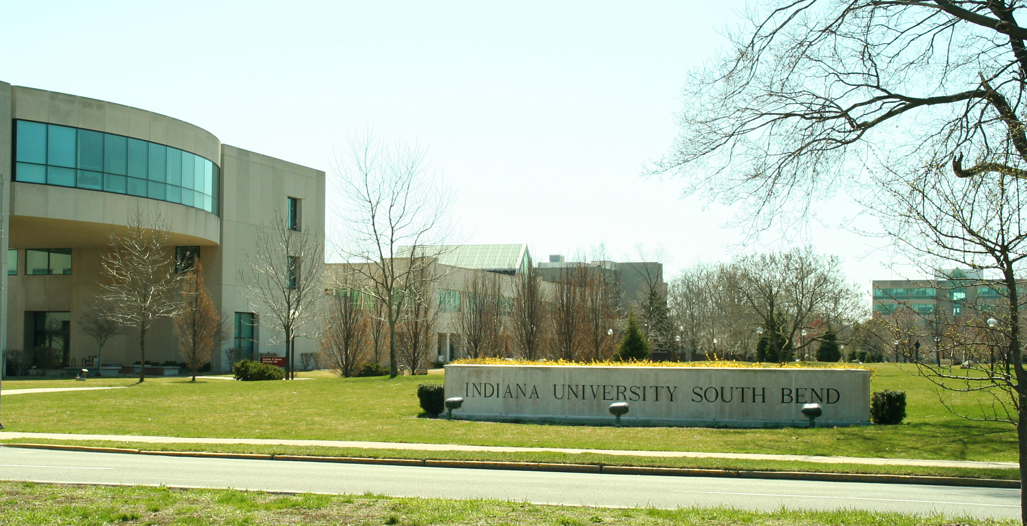
November Kudos

Slide 2
Women’s and Gender Studies
Christina Gerken presented “Gender, Politics, and Asylum Law: A Feminist Analysis of Gender-Based Claims by Unaccompanied Minors.” at the National Women’s Studies Association: Annual Conference in Montreal.
Andrea Rusnock is the chair for a roundtable, "New Conversations about Moscow Conceptualism" at the national conference of Association for Slavic, East European, and Eurasian Studies (ASEEES) in Washington, D.C. She also contributed to the roundtable: "Forty Years On: An Assessment of The Russian Avant-Garde: Theory and Criticism 1902- 34: A Roundtable in Honor of John Bowlt.”

Slide 3
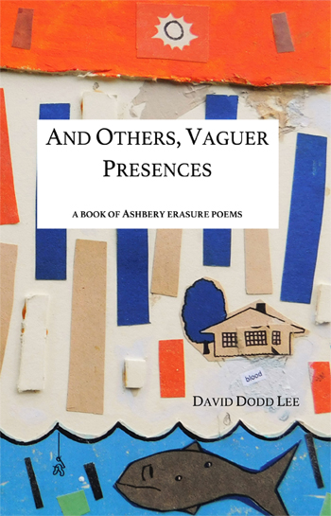
English
David Dodd Lee’s And Others, Vaguer Presences, A Book of Ashbery Erasure Poems is now available for pre-order from BlazeVOX and Amazon.
David also had two poems accepted in an upcoming issue of Prairie Schooner.

Slide 4
English
Kyoko Takanashi Presented “Making History Shareable: Fragments, Sentiment, and Nostalgia in Thackeray” at the Annual Conference of the North American Victorian Studies Association in Phoenix

Slide 5
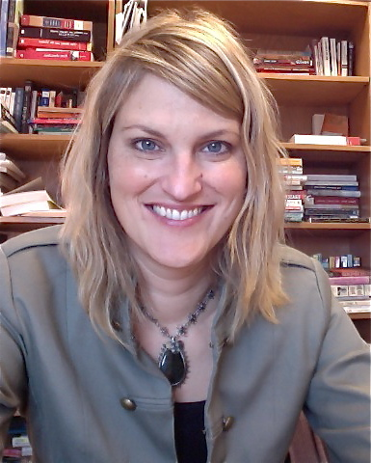
English
Kelcey Ervick published two personal essays: "My Viking Name," in the Colorado Review, and "How We Talk About Women's Lives,“ in LitHub. Kelcey also published a collage series: "no other story in the world was more authentic,“ in the Ilanot Review.
In addition, Kelcey was also a guest lecturer at Tennessee Tech University's Center Stage Artist Series, and a panelist at the Chicago Book Expo, "Beyond the Lines: Comics, Animation, Collage, and Re-Imagining the Book"

Slide 6
Sociology & Anthropology
Zach Schrank gave a talk: "Assessing Student Perceptions of Frequent Low-stakes Testing in Introductory Sociology Classes," for the Valparaiso Institute for Teaching and Learning, at Valparaiso University on November 14.
Solaiman Fazel attended the FALCON Conference in Indianapolis, and gave a talk as part of the International Education Week: "Research in Conflict Zone: Ethnohistory in Kabul"

Slide 7
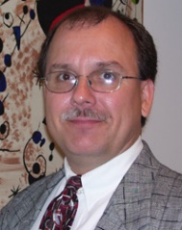
Psychology
Kevin Ladd published two articles: “A brief history of the psychological study of the role(s) of religion” in Enriching the Classroom Experience for Teachers and Students: Psychological Specialties in Historical Context and “Conceptualizing “prayer” for an East-West dialogue and beyond” in Psychological Studies.
Presentation:
Kevin also presented a paper: “Touching, moving magic” at the Magic and Meaning conference in Las Vegas, NV.

